Slide 1
Assembly Language for x86 Processors 7th Edition
Kip R. Irvine
Chapter 8: Advanced Procedures
Slides prepared by the author.
Revised by Zuoliu Ding at Fullerton College, 08/2014
(c) Pearson Education, 2015. All rights reserved. You may modify and copy this slide show for your personal use, or for use in the classroom, as long as this copyright statement, the author's name, and the title are not changed.

Slide 2
Chapter Overview
Stack Frames
Recursion
INVOKE, ADDR, PROC, and PROTO
Creating Multi-module Programs
Advanced Use of Parameters
Java Bytecodes (optional)
Irvine, Kip R. Assembly Language for x86 Processors 7/e, 2015.

Slide 3
Stack Frames
Stack Parameters
Local Variables
ENTER and LEAVE Instructions
LOCAL Directive
WriteStackFrame Procedure
Irvine, Kip R. Assembly Language for x86 Processors 7/e, 2015.

Slide 4
Stack Frame
Also known as an activation record
Area of the stack set aside for a procedure's return address, passed parameters, saved registers, and local variables
Created by the following steps:
  Calling program pushes arguments on the stack and calls the procedure.
  The called procedure pushes EBP on the stack, and sets EBP to ESP.
  If local variables are needed, a constant is subtracted from ESP to make room on the stack.
Irvine, Kip R. Assembly Language for x86 Processors 7/e, 2015.

Slide 5
Stack Parameters
More convenient than register parameters
Two possible ways of calling DumpMem. Which is easier?
Why need Stack Parameters?
  Anatomy of C code
pushad
mov esi,OFFSET array
mov ecx,LENGTHOF array
mov ebx,TYPE array
call DumpMem
popad
push TYPE array
push LENGTHOF array
push OFFSET array
call DumpMem
int AddTwo(int i, int j)
{
return i+j;
}
int f(int &i, bool b)
{
int n, m; // do...
return m;
}
int x = AddTwo(5, 6);
int y = f(x, true);
Irvine, Kip R. Assembly Language for x86 Processors 6/e, 2010.

Slide 6
Passing Arguments by Value
Push argument values on stack
  (Use only 32-bit values in protected mode to keep the stack aligned)
Call the called-procedure
Accept a return value in EAX, if any
Remove arguments from the stack if the called-procedure did not remove them
Irvine, Kip R. Assembly Language for x86 Processors 7/e, 2015.

Slide 7
Example
.data
val1 DWORD 5
val2 DWORD 6
.code
push val2
push val1
(val2) 6
(val1) 5 ESP
Stack prior to CALL
Irvine, Kip R. Assembly Language for x86 Processors 7/e, 2015.

Slide 8
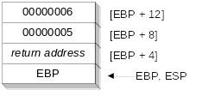
Passing Arguments by Value: AddTwo
int n = AddTwo( 5, 6 );
.data
sum DWORD ?
.code
push 6 ; second argument
push 5 ; first argument
call AddTwo ; EAX = sum
mov sum,eax ; save the sum
AddTwo PROC
push ebp
mov ebp,esp
.
.
Irvine, Kip R. Assembly Language for Intel-Based Computers 5/e, 2007.

Slide 9
Passing by Reference
Push the offsets of arguments on the stack
Call the procedure
Accept a return value in EAX, if any
Remove arguments from the stack if the called procedure did not remove them
Irvine, Kip R. Assembly Language for x86 Processors 7/e, 2015.

Slide 10
Example
.data
val1 DWORD 5
val2 DWORD 6
.code
push OFFSET val2
push OFFSET val1
(offset val2) 00000004
(offset val1) 00000000 ESP
Stack prior to CALL
Irvine, Kip R. Assembly Language for x86 Processors 7/e, 2015.

Slide 11
Stack after the CALL
value or addr of val2
value or addr of val1
return address
EBP
[EBP+12]
[EBP+8]
[EBP+4]
ESP, EBP
Irvine, Kip R. Assembly Language for x86 Processors 7/e, 2015.

Slide 12
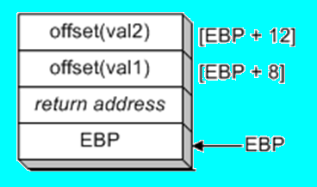
Passing Arguments by Reference: Swap
An argument passed by reference consists of the address (offset) of an object:
push offset val2
push offset val1
call Swap
In C/C++,
Swap(&val1, &val2);
Irvine, Kip R. Assembly Language for Intel-Based Computers 5/e, 2007.

Slide 13
Accessing Stack Parameters (C/C++)
C and C++ functions access stack parameters using constant offsets from EBP¹.
  Example: [ebp + 8]
EBP is called the base pointer or frame pointer because it holds the base address of the stack frame.
EBP does not change value during the function.
EBP must be restored to its original value when a function returns.
¹ BP in Real-address mode
Irvine, Kip R. Assembly Language for x86 Processors 7/e, 2015.

Slide 14
RET Instruction
Return from subroutine
Pops stack into the instruction pointer (EIP or IP). Control transfers to the target address.
Syntax:
  RET
  RET n
Optional operand n causes n bytes to be added to the stack pointer after EIP (or IP) is assigned a value.
Irvine, Kip R. Assembly Language for x86 Processors 7/e, 2015.

Slide 15
Who removes parameters from the stack?
Caller (C) ...... or ...... Called-procedure (STDCALL):
AddTwo PROC
push val2 push ebp
push val1 mov ebp,esp
call AddTwo mov eax,[ebp+12]
add esp,8 add eax,[ebp+8]
pop ebp
ret 8
( Covered later: The MODEL directive specifies calling conventions )
Irvine, Kip R. Assembly Language for x86 Processors 7/e, 2015.

Slide 16
C Call : Caller releases stack
RET does not clean up the stack.
AddTwo_C PROC
push ebp
mov ebp,esp
mov eax,[ebp + 12] ; second parameter
add eax,[ebp + 8] ; first parameter
pop ebp
ret ; caller cleans up the stack
AddTwo_C ENDP
_Example1 PROC
push 6
push 5
call AddTwo_C
add esp,8 ; clean up the stack
call DumpRegs ; sum is in EAX
ret
_Example1 ENDP
Irvine, Kip R. Assembly Language for Intel-Based Computers 5/e, 2007.

Slide 17
STDCall : Procedure releases stack
The RET n instruction cleans up the stack.
AddTwo PROC
push ebp
mov ebp,esp
mov eax,[ebp + 12] ; second parameter
add eax,[ebp + 8] ; first parameter
pop ebp
ret 8 ; clean up the stack
AddTwo ENDP
_Example2 PROC
push 6
push 5
call AddTwo
call DumpRegs ; sum is in EAX
ret
_Example2 ENDP
Irvine, Kip R. Assembly Language for Intel-Based Computers 5/e, 2007.

Slide 18
Passing an Array by Reference (1 of 2)
The ArrayFill procedure fills an array with 16-bit random integers
The calling program passes the address of the array, along with a count of the number of array elements:
.data
count = 100
array WORD count DUP(?)
.code
push OFFSET array
push COUNT
call ArrayFill
Irvine, Kip R. Assembly Language for x86 Processors 7/e, 2015.

Slide 19
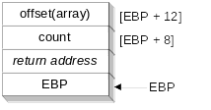
Passing an Array by Reference (2 of 2)
ArrayFill can reference an array without knowing the array's name:
ArrayFill PROC
push ebp
mov ebp,esp
pushad
mov esi,[ebp+12]
mov ecx,[ebp+8]
.
.
ESI points to the beginning of the array, so it's easy to use a loop to access each array element. View the complete program.
Irvine, Kip R. Assembly Language for x86 Processors 7/e, 2015.

Slide 20
ArrayFill Procedure
ArrayFill PROC
push ebp
mov ebp,esp
pushad ; save registers
mov esi,[ebp+12] ; offset of array, beginning
mov ecx,[ebp+8] ; array size
cmp ecx,0 ; ECX == 0?
je L2 ; yes: skip over loop
L1: mov eax,10000h ; get random 0 - FFFFh
call RandomRange ; from the link library
mov [esi],ax
add esi,TYPE WORD
loop L1
L2: popad ; restore registers
pop ebp
ret 8 ; clean up the stack
ArrayFill ENDP
Irvine, Kip R. Assembly Language for Intel-Based Computers 5/e, 2007.

Slide 21
Your turn . . .
Create a procedure named Difference that subtracts the first argument from the second one. Following is a sample call: (30 – 14 = 16)
    push 14 ; second argument, subtrahend
    push 30 ; first argument, minuend
    call Difference ; EAX = 16
int diff =Difference(30, 14);
Difference PROC
  push ebp
  mov ebp,esp
  mov eax,[ebp + 8] ; first argument (30)
  sub eax,[ebp + 12] ; second argument (14)
  pop ebp
  ret 8
Difference ENDP
Irvine, Kip R. Assembly Language for x86 Processors 6/e, 2010.

Slide 22
Local Variables
Only statements within subroutine can view or modify local variables
Storage used by local variables is released when subroutine ends
local variable name can have the same name as a local variable in another function without creating a name clash
Essential when writing recursive procedures, as well as procedures executed by multiple execution threads
Irvine, Kip R. Assembly Language for x86 Processors 7/e, 2015.

Slide 23
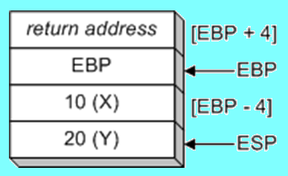
Local Variables
To explicitly create local variables, subtract total size from ESP.
void MySub()
{
int X=10;
int Y=20;
}
MySub PROC
push ebp
mov ebp,esp
sub esp,8 ; create variables
mov DWORD PTR [ebp-4],10 ; X
mov DWORD PTR [ebp-8],20 ; Y
; ... Do something
mov esp,ebp ; remove locals from stack
pop ebp
ret
MySub ENDP LocalVars.asm
Irvine, Kip R. Assembly Language for Intel-Based Computers 5/e, 2007.

Slide 24
ENTER and LEAVE
ENTER instruction creates stack frame for a called procedure
  pushes EBP on the stack (push ebp)
  sets EBP to the base of the stack frame (mov ebp, esp)
  reserves space for local variables (sub esp, n)
  Syntax: ENTER numBytesReserved, nestingLevel (=0)
LEAVE instruction terminates the stack frame for a called procedure
  restores ESP to release local variables (mov esp, ebp)
  pops EBP for the caller (pop ebp)
Irvine, Kip R. Assembly Language for Intel-Based Computers 5/e, 2007.

Slide 25
LEAVE Instruction
Terminates the stack frame for a procedure.
Equivalent operations
MySub PROC
enter 8,0
...
...
...
leave
ret
MySub ENDP
push ebp
mov ebp,esp
sub esp,8 ; 2 local DWORDs
mov esp,ebp ; free local space
pop ebp
Irvine, Kip R. Assembly Language for x86 Processors 7/e, 2015.

Slide 26
LOCAL Directive
The LOCAL directive declares a list of local variables
  immediately follows the PROC directive
  each variable is assigned a type
Syntax:
    LOCAL varlist
Example:
MySub PROC
LOCAL var1:BYTE, var2:WORD, var3:SDWORD
Irvine, Kip R. Assembly Language for x86 Processors 7/e, 2015.

Slide 27
Using LOCAL
Examples:
LOCAL flagVals[20]:BYTE ; array of bytes
LOCAL pArray:PTR WORD ; pointer to an array
myProc PROC, ; procedure
LOCAL t1:BYTE, ; local variables
Irvine, Kip R. Assembly Language for x86 Processors 7/e, 2015.

Slide 28
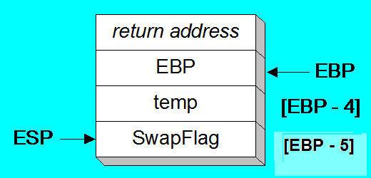
LOCAL Example
BubbleSort PROC
LOCAL temp:DWORD,
SwapFlag:BYTE
. . .
ret
BubbleSort ENDP
MASM generates:
BubbleSort PROC
push ebp ; enter 8, 0
mov ebp,esp
add esp,0FFFFFFF8h ; add -8 to ESP
. . .
mov esp,ebp ; leave
pop ebp
ret
BubbleSort ENDP See LocalExample.asm
Irvine, Kip R. Assembly Language for Intel-Based Computers 5/e, 2007.

Slide 29
LEA Instruction
LEA returns offsets of direct and indirect operands
  OFFSET operator only returns constant offsets
LEA required when obtaining offsets of stack parameters & local variables
Example
CopyString PROC,
count:DWORD
LOCAL temp[20]:BYTE
mov edi,OFFSET count ; invalid operand
mov esi,OFFSET temp ; invalid operand
lea edi,count ; ok
lea esi,temp ; ok
An example of C++ equivalent assembly code, see text
Irvine, Kip R. Assembly Language for x86 Processors 7/e, 2015.

Slide 30
LEA Example
Suppose you have a Local variable at [ebp-8]
And you need the address of that local variable in ESI
You cannot use this:
mov esi, OFFSET [ebp-8] ; error
Use this instead:
lea esi,[ebp-8]
Irvine, Kip R. Assembly Language for x86 Processors 7/e, 2015.

Slide 31
WriteStackFrame Procedure
Displays contents of current stack frame
  Prototype:
    WriteStackFrame PROTO,
    numParam:DWORD, ; number of passed parameters
    numLocalVal: DWORD, ; number of DWordLocal variables
    numSavedReg: DWORD ; number of saved registers
Irvine, Kip R. Assembly Language for x86 Processors 7/e, 2015.

Slide 32
WriteStackFrame Example
    main PROC
    mov eax, 0EAEAEAEAh
    mov ebx, 0EBEBEBEBh
    INVOKE aProc, 1111h, 2222h
    exit
    main ENDP
    aProc PROC USES eax ebx,
    x: DWORD, y: DWORD
    LOCAL a:DWORD, b:DWORD
    PARAMS = 2
    LOCALS = 2
    SAVED_REGS = 2
    mov a,0AAAAh
    mov b,0BBBBh
    INVOKE WriteStackFrame, PARAMS, LOCALS, SAVED_REGS
Irvine, Kip R. Assembly Language for x86 Processors 7/e, 2015.

Slide 33
All in Stack Frame
Parameter n
... …
Parameter 1
Return Address
EBP
Local Variable 1
… …
Local Variable m
Register 1
… …
Register k
[EBP+8]
push EBP
mov EBP,ESP
mov ESP,EBP
pop EBP
⬅EBP
Prologue Epilogue
⬅
⬅
⬅ESP
Irvine, Kip R. Assembly Language for Intel-Based Computers 5/e, 2007.

Slide 34
Review
(True/False): A subroutine’s stack frame always contains the caller’s return address and the subroutine’s local variables.
(True/False): Arrays are passed by reference to avoid copying them onto the stack.
(True/False): A procedure’s prologue code always pushes EBP on the stack.
(True/False): Local variables are created by adding an integer to the stack pointer.
(True/False): In 32-bit protected mode, the last argument to be pushed on the stack in a procedure call is stored at location ebp+8.
(True/False): Passing by reference requires popping a parameter’s offset from the stack inside the called procedure.
What are two common types of stack parameters?
T
T
T
F
T
T
v, r
Irvine, Kip R. Assembly Language for x86 Processors 6/e, 2010.

Slide 35
What's Next
Stack Frames
Recursion
INVOKE, ADDR, PROC, and PROTO
Creating Multi-module Programs
Advanced Use of Parameters
Java Bytecodes (optional)
Irvine, Kip R. Assembly Language for x86 Processors 7/e, 2015.

Slide 36
Recursion
What is Recursion?
Recursively Calculating a Sum
Calculating a Factorial
Irvine, Kip R. Assembly Language for x86 Processors 7/e, 2015.

Slide 37
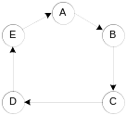
What is Recursion?
The process created when . . .
  A procedure calls itself
  Procedure A calls procedure B, which in turn calls procedure A
Using a graph in which each node is a procedure and each edge is a procedure call, recursion forms a cycle:
Irvine, Kip R. Assembly Language for x86 Processors 7/e, 2015.

Slide 38
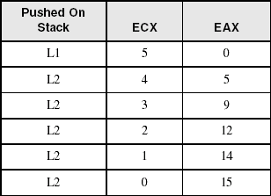
Recursively Calculating a Sum
The CalcSum procedure recursively calculates the sum of an array of integers. Receives: ECX = count. Returns: EAX = sum
CalcSum PROC
cmp ecx,0 ; check counter value
  jz L2 ; quit if zero
  add eax,ecx ; otherwise, add to sum
  dec ecx ; decrement counter
  call CalcSum ; recursive call
L2: ret
CalcSum ENDP
View the complete program
Stack frame:
Irvine, Kip R. Assembly Language for x86 Processors 7/e, 2015.

Slide 39
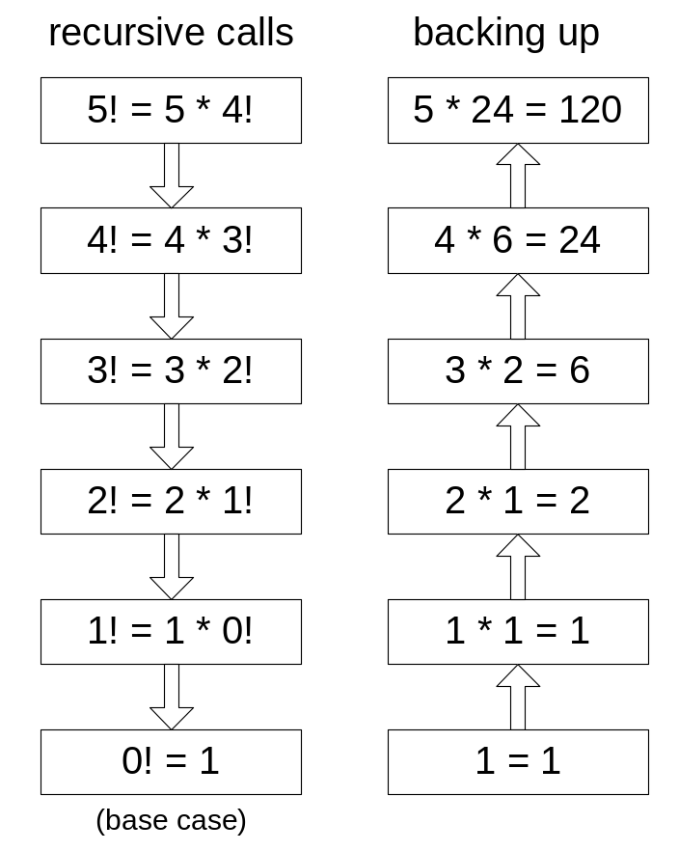
Calculating a Factorial (1 of 3)
This function calculates the factorial of integer n. A new value of n is saved in each stack frame:
int factorial(int n)
{
if(n == 0)
return 1;
else
return n * factorial(n-1);
}
As each call instance returns, the product it returns is multiplied by the previous value of n.
Irvine, Kip R. Assembly Language for x86 Processors 7/e, 2015.

Slide 40
Calculating a Factorial (2 of 3)
Factorial PROC
push ebp
mov ebp,esp
mov eax,[ebp+8] ; get n
cmp eax,0 ; n > 0?
ja L1 ; yes: continue
mov eax,1 ; no: return 1
jmp L2
L1: dec eax
push eax ; Factorial(n-1)
call Factorial
; Instructions from this point on excursion when each recursive call returns.
ReturnFact:
mov ebx,[ebp+8] ; get n
mul ebx ; eax = eax * ebx
L2: pop ebp ; return EAX
ret 4 ; clean up stack
Factorial ENDP
Irvine, Kip R. Assembly Language for x86 Processors 7/e, 2015.

Slide 41
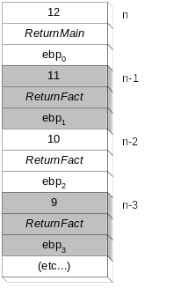
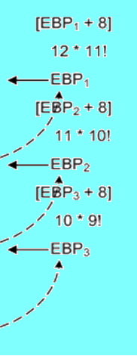
Calculating a Factorial (3 of 3)
Suppose we want to calculate 12!
This diagram shows the first few stack frames created by recursive calls to Factorial
Each recursive call uses 12 bytes of stack space.
Irvine, Kip R. Assembly Language for x86 Processors 7/e, 2015.

Slide 42
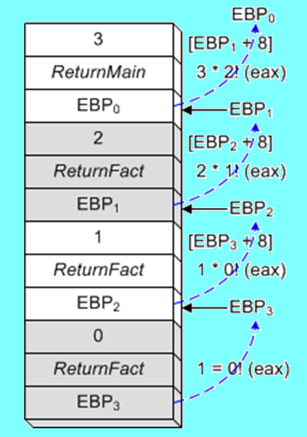
=> F: push ebp0, eax is 3
L1, eax=2, push 2
=> F: push ebp1, eax is 2
L1, eax=1, push 1
=> F: push ebp2, eax is 1
L1, eax=0, push 0
=> F: push ebp3, eax is 0
eax=1
L2, pop ebp3
<=
[ebp3+8] is 1, 1*1
L2, pop ebp2
<=
[ebp2+8] is 2, 1*2
L2, pop ebp1
<=
[ebp1+8] is 3, 2*3
L2, pop ebp0
<=
eax is 6
RetuenMain
Irvine, Kip R. Assembly Language for Intel-Based Computers 5/e, 2007. Added by Zuoliu Ding

Slide 43
Review
(True/False): Given the same task to accomplish, a recursive subroutine usually uses less memory than a nonrecursive one.
In the Factorial function, what condition terminates the recursion?
Which instructions in the assembly language Factorial procedure execute after each recursive call has finished?
What will happen to the Factorial program’s output when trying to calculate 13 factorial?
Challenge: In the Factorial program, how many bytes of stack space are used by the Factorial procedure when calculating 12 factorial?
Challenge: Write the pseudocode for a recursive algorithm that generates the first 20 integers of the Fibonacci series (1, 1, 2, 3, 5, 8, 13, 21, . . .).
F
n=0
RF
UO
156
…
Irvine, Kip R. Assembly Language for x86 Processors 6/e, 2010.

Slide 44
What's Next
Stack Frames
Recursion
INVOKE, ADDR, PROC, and PROTO
Creating Multi-module Programs
Java Bytecodes
Irvine, Kip R. Assembly Language for x86 Processors 7/e, 2015.

Slide 45
INVOKE, ADDR, PROC, and PROTO
INVOKE Directive
ADDR Operator
PROC Directive
PROTO Directive
Parameter Classifications
Example: Exchaning Two Integers
Debugging Tips
Irvine, Kip R. Assembly Language for x86 Processors 7/e, 2015.

Slide 46
INVOKE Directive
Not in 64-bit mode!
In 32-bit mode, the INVOKE directive is a powerful replacement for Intel’s CALL instruction that lets you pass multiple arguments
Syntax:
    INVOKE procedureName [, argumentList]
ArgumentList is an optional comma-delimited list of procedure arguments
Arguments can be:
  immediate values and integer expressions
  variable names
  address and ADDR expressions
  register names
Irvine, Kip R. Assembly Language for x86 Processors 7/e, 2015.

Slide 47
INVOKE Examples
.data
byteVal BYTE 10
wordVal WORD 1000h
.code
; direct operands:
INVOKE Sub1,byteVal,wordVal
; address of variable:
INVOKE Sub2,ADDR byteVal
; register name, integer expression:
INVOKE Sub3,eax,(10 * 20)
; address expression (indirect operand):
INVOKE Sub4,[ebx]
Irvine, Kip R. Assembly Language for x86 Processors 7/e, 2015.

Slide 48
ADDR Operator
Not in 64-bit mode!
Returns a near or far pointer to a variable, depending on which memory model your program uses:
  Small model: returns 16-bit offset
  Large model: returns 32-bit segment/offset
  Flat model: returns 32-bit offset
Simple example:
.data
myWord WORD ?
.code
INVOKE mySub,ADDR myWord
Irvine, Kip R. Assembly Language for x86 Processors 7/e, 2015.

Slide 49
PROC Directive (1 of 2)
Not in 64-bit mode!
The PROC directive declares a procedure
  Syntax:
  label PROC [attributes] [USES regList], paramList
The USES clause must be on the same line as PROC.
Attributes: distance, language type, visibility
ParamList is a list of parameters separated by commas.
  label PROC, parameter1, parameter2, …, parameterN
  Each parameter has the following syntax:
  paramName : type
type must either be one of the standard ASM types (BYTE, SBYTE, WORD, etc.), or it can be a pointer to one of these types.
Irvine, Kip R. Assembly Language for x86 Processors 7/e, 2015.

Slide 50
PROC Directive (2 of 2)
Alternate format permits parameter list to be on one or more separate lines:
  label PROC,
  paramList
The parameters can be on the same line . . .
  param-1:type-1, param-2:type-2, . . ., param-n:type-n
Or they can be on separate lines:
  param-1:type-1,
  param-2:type-2,
  . . .,
  param-n:type-n
comma required
Irvine, Kip R. Assembly Language for x86 Processors 7/e, 2015.

Slide 51
Example: AddTwo Procedure
AddTwo receives two integers and returns their sum in EAX.
See Params.asm
MASM Generates:
AddTwo PROC,
val1:DWORD, val2:DWORD
push ebp
mov ebp, esp
mov eax,val1
add eax,val2
leave
ret 00008h
AddTwo ENDP
___________________________
sub esp, 002h
push myData
push +000000001h
call AddTwo
AddTwo PROC,
val1:DWORD, val2:DWORD
mov eax,val1
add eax,val2
ret
AddTwo ENDP
___________________________
myData WORD 1000h
invoke AddTwo, 1, myData
Irvine, Kip R. Assembly Language for Intel-Based Computers 5/e, 2007.

Slide 52
Example: FillArray
FillArray receives a pointer to an array of bytes, a single byte fill value that will be copied to each element of the array, and the size of the array.
FillArray PROC,
pArray:PTR BYTE, fillVal:BYTE
arraySize:DWORD
mov ecx,arraySize
mov esi,pArray
mov al,fillVal
L1: mov [esi],al
inc esi
loop L1
ret
FillArray ENDP
Irvine, Kip R. Assembly Language for x86 Processors 7/e, 2015.

Slide 53
Example: Read_File PROC
MASM Generates: See Params.asm
Read_File PROC
push ebp
mov ebp, esp
add esp, 0FFFFFFFCh ;Local
push eax
push ebx
mov esi, dword ptr [ebp+8]
mov dword ptr [ebp-4], eax
; ... …
pop ebx
pop eax
leave ;mov esp, ebp
;pop ebp
ret 00004h
Read_File ENDP
Read_File PROC USES eax ebx,
pBuffer:PTR BYTE
LOCAL fileHandle:DWORD
mov esi, pBuffer
mov fileHandle, eax
;... ...
ret
Read_File ENDP
Irvine, Kip R. Assembly Language for Intel-Based Computers 5/e, 2007.

Slide 54
PROTO Directive
Creates a procedure prototype
Syntax:
  label PROTO paramList
Parameter list not permitted in 64-bit mode
Every procedure called by the INVOKE directive must have a prototype
A complete procedure definition can also serve as its own prototype
Irvine, Kip R. Assembly Language for x86 Processors 7/e, 2015.

Slide 55
PROTO Directive
Standard configuration: PROTO appears at top of the program listing, INVOKE appears in the code segment, and the procedure implementation occurs later in the program:
MySub PROTO ; procedure prototype
.code
INVOKE MySub ; procedure call
MySub PROC ; procedure implementation
.
.
MySub ENDP
Irvine, Kip R. Assembly Language for x86 Processors 7/e, 2015.

Slide 56
PROTO Example
Prototype for the ArraySum procedure, showing its parameter list:
ArraySum PROC USES esi ecx,
ptrArray:PTR DWORD, ; points to the array
szArray:DWORD ; array size
...
ArraySum ENDP
ArraySum PROTO,
ptrArray:PTR DWORD, ; points to the array
szArray:DWORD ; array size
Parameters are not permitted in 64-bit mode.
Irvine, Kip R. Assembly Language for x86 Processors 7/e, 2015.

Slide 57
Assembly Time Argument Checking
mySub1 PROTO, p1:BYTE, p2:WORD, p3:PTR BYTE
invoke mySub1, byte_1, byte_1, ADDR byte_1
MASM Generates the following and no error detected:
0000001A 68 00000000 R * push OFFSET byte_1
0000001F A0 00000000 R * mov al, byte_1
00000024 0F B6 C0 * movzx eax, al
00000027 50 * push eax
00000028 A0 00000000 R * mov al, byte_1
0000002D 50 * push eax
0000002E E8 00000022 * call mySub1
Explain why use movzx and push eax?
See 8.4.4, P305-307 for details
Irvine, Kip R. Assembly Language for Intel-Based Computers 5/e, 2007.

Slide 58
Parameter Classifications
An input parameter is data passed by a calling program to a procedure.
  The called procedure is not expected to modify the corresponding parameter variable, and even if it does, the modification is confined to the procedure itself.
An output parameter is created by passing a pointer to a variable when a procedure is called.
  The procedure does not use any existing data from the variable, but it fills in a new value before it returns.
An input-output parameter is a pointer to a variable containing input that will be both used and modified by the procedure.
  The variable passed by the calling program is modified.
Irvine, Kip R. Assembly Language for x86 Processors 7/e, 2015.

Slide 59
Example: Exchanging Two Integers
The Swap procedure exchanges the values of two 32-bit integers. pValX and pValY do not change values, but the integers they point to are modified.
Swap PROC USES eax esi edi,
  pValX:PTR DWORD, ; pointer to first integer
  pValY:PTR DWORD ; pointer to second integer
  mov esi,pValX ; get pointers
  mov edi,pValY
  mov eax,[esi] ; get first integer
  xchg eax,[edi] ; exchange with second
  mov [esi],eax ; replace first integer
  ret
Swap ENDP
Demo: Swap.asm
What if don’t use xchg?
Irvine, Kip R. Assembly Language for Intel-Based Computers 5/e, 2007.

Slide 60
Trouble-Shooting Tips
Save and restore registers when they are modified by a procedure.
  Except a register that returns a function result
When using INVOKE, be careful to pass a pointer to the correct data type.
  For example, MASM cannot distinguish between a DWORD argument and a PTR BYTE argument.
Do not pass an immediate value to a procedure that expects a reference parameter.
  Dereferencing its address will likely cause a general-protection fault.
Irvine, Kip R. Assembly Language for x86 Processors 7/e, 2015.

Slide 61
Using VARARG
invoke addup3, 3, 5, 2, 4
addup3 PROC NEAR C, argcount:WORD, arg1:VARARG
sub ax, ax ; Clear work register
sub si, si
.WHILE argcount > 0 ; number of arguments
add ax, arg1[si] ; Arg1 has the first argument
dec argcount ; Point to next argument
inc si
inc si
.ENDW
ret ; Total is in AX
addup3 ENDP
Microsoft MASM 6.1 Programmer's Guide, p149
http://staffwww.fullcoll.edu/zding/fc241/files/MASM61PROGUIDE.pdf
Irvine, Kip R. Assembly Language for x86 Processors 6/e, 2010.

Slide 62
What's Next
Stack Frames
Recursion
INVOKE, ADDR, PROC, and PROTO
Creating Multi-module Programs
Advanced Use of Parameters
Java Bytecodes (optional)
Irvine, Kip R. Assembly Language for x86 Processors 7/e, 2015.

Slide 63
Multi-module Programs
A Multi-module program is a program whose source code has been divided up into separate ASM files.
Each ASM file (module) is assembled into a separate OBJ file.
All OBJ files belonging to the same program are linked using the link utility into a single EXE file.
  This process is called static linking
Irvine, Kip R. Assembly Language for x86 Processors 7/e, 2015.

Slide 64
Advantages
Large programs are easier to write, maintain, and debug when divided into separate source code modules.
When changing a line of code, only its enclosing module needs to be assembled again. Linking assembled modules requires little time.
A module can be a container for logically related code and data (think object-oriented here...)
  encapsulation: procedures and variables are automatically hidden in a module unless you declare them public
Irvine, Kip R. Assembly Language for x86 Processors 7/e, 2015.

Slide 65
Creating a Multi-module Program
Here are some basic steps to follow when creating a Multi-module program:
  Create the main module
  Create a separate source code module for each procedure or set of related procedures
  Create an include file that contains procedure prototypes for external procedures (ones that are called between modules)
  Use the INCLUDE directive to make your procedure prototypes available to each module
Irvine, Kip R. Assembly Language for x86 Processors 7/e, 2015.

Slide 66
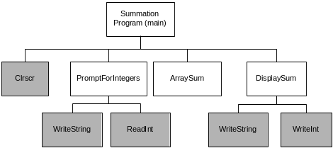
Example: ArraySum Program
Let's review the ArraySum program from Chapter 5.
Each of the four white rectangles will become a module. This will be a 32-bit application.
Irvine, Kip R. Assembly Language for x86 Processors 7/e, 2015.

Slide 67
Sample Program output
Enter a signed integer: -25
Enter a signed integer: 36
Enter a signed integer: 42
The sum of the integers is: +53
Irvine, Kip R. Assembly Language for x86 Processors 7/e, 2015.

Slide 68
Three Examples: Array Sum
Compare 5.6.2 (p175) using Register Parameters
Now 8.5.5, use Stack Parameters (ModSum32_traditional.asm)
Now 8.5.6, use PROC and Invoke (ModSum32_advanced.asm)
Discuss the differences
Which one is your preferred?
Irvine, Kip R. Assembly Language for Intel-Based Computers 5/e, 2007.

Slide 69
INCLUDE File
The sum.inc file contains prototypes for external functions that are not in the Irvine32 library:
INCLUDE Irvine32.inc
PromptForIntegers PROTO,
ptrPrompt:PTR BYTE, ; prompt string
ptrArray:PTR DWORD, ; points to the array
arraySize:DWORD ; size of the array
ArraySum PROTO,
ptrArray:PTR DWORD, ; points to the array
count:DWORD ; size of the array
DisplaySum PROTO,
ptrPrompt:PTR BYTE, ; prompt string
theSum:DWORD ; sum of the array
Irvine, Kip R. Assembly Language for x86 Processors 7/e, 2015.

Slide 70
Inspect Individual Modules
Main
PromptForIntegers
ArraySum
DisplaySum
Function name mangling / name decoration
Irvine, Kip R. Assembly Language for x86 Processors 7/e, 2015.

Slide 71
What's Next
Stack Frames
Recursion
INVOKE, ADDR, PROC, and PROTO
Creating Multi-module Programs
Advanced Use of Parameters
Java Bytecodes (optional)
Irvine, Kip R. Assembly Language for x86 Processors 7/e, 2015.

Slide 72
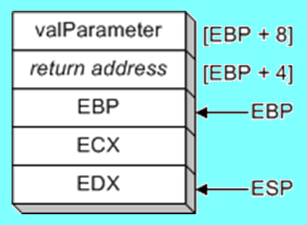
Saving and Restoring Registers
Push registers on stack just after assigning ESP to EBP
  local registers are modified inside the procedure
MySub_ PROC
push ebp mov ebp,esp push ecx
push edx mov eax,[ebp+8]
; Do something...
pop edx pop ecx
pop ebp
ret 4
MySub_ ENDP
Procedure using explicit stack parameters should avoid the USES operator, if no LOCAL or Proc parameters.
Irvine, Kip R. Assembly Language for x86 Processors 6/e, 2010.

Slide 73
Stack Affected by USES Operator
    MySub1 PROC USES ecx edx
    push ebp
    mov ebp,esp
    mov eax,[ebp+8]
    ; ...
    ret
    MySub1 ENDP
USES operator generates:
MySub1 PROC
push ecx
push edx
push ebp
mov ebp,esp
mov eax,[ebp+8]
; ...
pop edx
pop ecx
ret
Where is ebp+8 pointing to?
ECX
See UsesTest.asm
Irvine, Kip R. Assembly Language for x86 Processors 6/e, 2010.

Slide 74
Passing 8-bit and 16-bit Arguments
Cannot push 8-bit values on stack
Pushing 16-bit operand may cause page fault or ESP alignment problem
  incompatible with Windows API functions
Expand smaller arguments into 32-bit values, using MOVZX or MOVSX:
    .data
    charVal BYTE 'x'
    .code
    movzx eax,charVal
    push eax
    call Uppercase
Irvine, Kip R. Assembly Language for x86 Processors 7/e, 2015.

Slide 75
Passing 64-bit Arguments
Push high-order values on the stack first; work backward in memory
Results in little-endian ordering of data
Example:
    .data
    longVal QWORD 1234567800ABCDEFh
    .code
    push DWORD PTR longVal + 4 ; high doubleword
    ; 12345678
    push DWORD PTR longVal ; low doubleword
    call WriteHex64
What’s stack memory look like?
ef cd ab 00 78 56 34 12
Irvine, Kip R. Assembly Language for x86 Processors 6/e, 2010.

Slide 76
Passing 64-bit Arguments, WriteHex64
When passing multiword integers to procedures using the stack, push the highorder part first, working down to the low-order part. Doing so places the integer into the stack in little endian order
WriteHex64 PROC
  push ebp
  mov ebp,esp
  mov eax,[ebp+12] ; high doubleword
  call WriteHex
  mov eax,[ebp+8] ; low doubleword
  call WriteHex
  pop ebp
  ret 8
WriteHex64 ENDP
Irvine, Kip R. Assembly Language for x86 Processors 7/e, Added by Zuoliu Ding.

Slide 77
Non-Doubleword Local Variables
Local variables can be different sizes
How created in the stack by LOCAL directive:
  8-bit: assigned to next available byte
  16-bit: assigned to next even (word) boundary
  32-bit: assigned to next doubleword boundary
Irvine, Kip R. Assembly Language for x86 Processors 7/e, 2015.

Slide 78
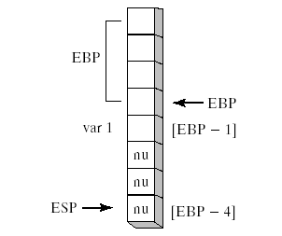
Local Byte Variable
    Example1 PROC
    LOCAL var1:BYTE
    mov al,var1 ; [EBP - 1]
    ret
    Example1 ENDP
As stack offsets default to 32 bits, decrement ESP by 4
Place var1 at [EBP-1] and leave three bytes below it unused (nu)
Irvine, Kip R. Assembly Language for x86 Processors 6/e, 2010.

Slide 79
The Microsoft x64 Calling Convention
CALL subtracts 8 from RSP
First four parameters are placed in RCX, RDX, R8, and R9. Additional parameters are pushed on the stack.
Parameters less than 64 bits long are not zero extended
Return value in RAX if <= 64 bits
Caller must allocate at least 32 bytes of shadow space so the subroutine can copy parameter values
Irvine, Kip R. Assembly Language for x86 Processors 7/e, 2015.

Slide 80
The Microsoft x64 Calling Convention
Caller must align RSP to 16-byte boundary
Caller must remove all parameters from the stack after the call
Return value larger than 64 bits must be placed on the runtime stack, with RCX pointing to it
RBX, RBP, RDI, RSI, R12, R14, R14, and R15 registers are preserved by the subroutine; all others are not.
Overview of x64 Calling Conventions: https://msdn.microsoft.com/en-us/library/ms235286.aspx
Irvine, Kip R. Assembly Language for x86 Processors 7/e, 2015.

Slide 81
What's Next
Stack Frames
Recursion
INVOKE, ADDR, PROC, and PROTO
Creating Multi-module Programs
Advanced Use of Parameters
Java Bytecodes (optional)
Irvine, Kip R. Assembly Language for x86 Processors 7/e, 2015.

Slide 82
Java Bytecodes
Stack-oriented instruction format
  operands are on the stack
  instructions pop the operands, process, and push result back on stack
Each operation is atomic
Might be be translated into native code by a just in time compiler
Irvine, Kip R. Assembly Language for x86 Processors 7/e, 2015.

Slide 83
Java Virual Machine (JVM)
Essential part of the Java Platform
Executes compiled bytecodes
  machine language of compiled Java programs
Irvine, Kip R. Assembly Language for x86 Processors 7/e, 2015.

Slide 84
Java Methods
Each method has its own stack frame
Areas of the stack frame:
  local variables
  operands
  execution environment
Irvine, Kip R. Assembly Language for x86 Processors 7/e, 2015.

Slide 85
Bytecode Instruction Format
1-byte opcode
  iload, istore, imul, goto, etc.
zero or more operands
Disassembling Bytecodes
  use javap.exe, in the Java Development Kit (JDK)
Irvine, Kip R. Assembly Language for x86 Processors 7/e, 2015.

Slide 86
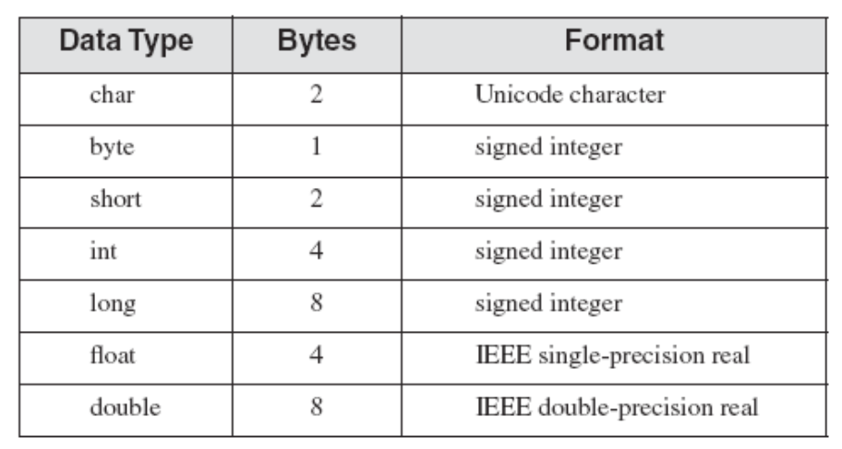
Primitive Data Types
Signed integers are in twos complement format, stored in big-endian order
Irvine, Kip R. Assembly Language for x86 Processors 7/e, 2015.

Slide 87
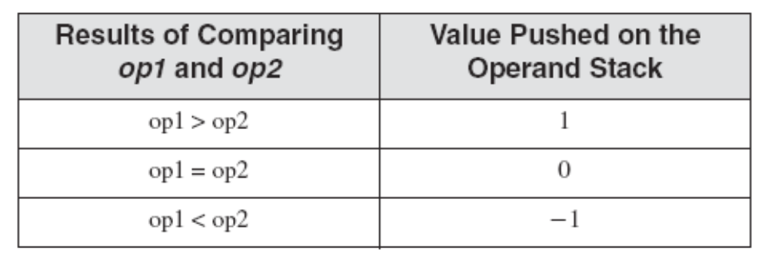
JVM Instruction Set
Comparison Instructions pop two operands off the stack, compare them, and push the result of the comparison back on the stack
Examples: fcmp and dcmp
Irvine, Kip R. Assembly Language for x86 Processors 7/e, 2015.

Slide 88
JVM Instruction Set
Conditional Branching
  jump to label if st(0) <= 0
    ifle label
Unconditional Branching
  call subroutine
    jsr label
Irvine, Kip R. Assembly Language for x86 Processors 7/e, 2015.

Slide 89
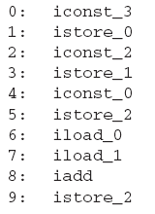
Java Disassembly Examples
Adding Two Integers
    int A = 3;
    int B = 2;
    int sum = 0;
    sum = A + B;
Irvine, Kip R. Assembly Language for x86 Processors 7/e, 2015.

Slide 90
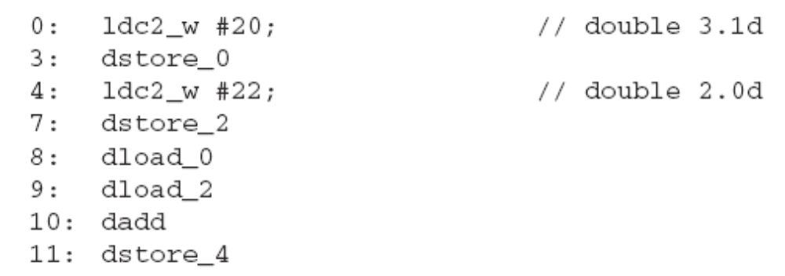
Java Disassembly Examples
Adding Two Doubles
    double A = 3.1;
    double B = 2;
    double sum = A + B;
Irvine, Kip R. Assembly Language for x86 Processors 7/e, 2015.

Slide 91
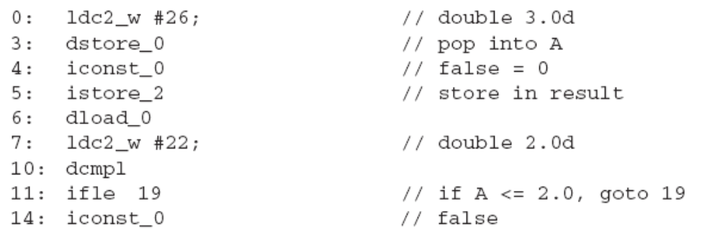
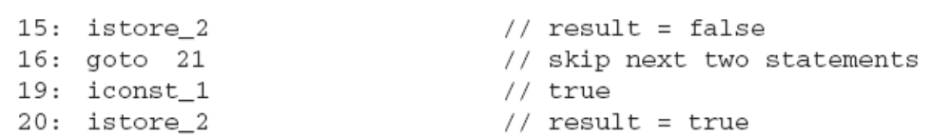
Java Disassembly Examples
Conditional Branch
    double A = 3.0;
    boolean result = false;
    if( A > 2.0 )
    result = false;
    else
    result = true;
Irvine, Kip R. Assembly Language for x86 Processors 7/e, 2015.

Slide 92
.NET Assembly in CLR
The .NET Framework provides a run-time environment called the common language runtime, which runs the code and provides .NET services.
Assemblies are the building blocks of .NET Framework applications.
You can use the Ildasm.exe (MSIL Disassembler) to view Microsoft intermediate language (MSIL) information in a file.
  Ildasm.exe Tutorial at
    https://msdn.microsoft.com/en-us/library/aa309387%28v=vs.71%29.aspx
Demo of Disassembly: A C# console application.
Irvine, Kip R. Assembly Language for x86 Processors 6/e, 2010.

Slide 93
Summary
Stack parameters
  more convenient than register parameters
  passed by value or reference
  ENTER and LEAVE instructions
Local variables
  created on the stack below stack pointer
  LOCAL directive
Recursive procedure calls itself
Calling conventions (C, stdcall)
MASM procedure-related directives
  INVOKE, PROC, PROTO
Java Bytecodes – another approch to programming
Irvine, Kip R. Assembly Language for x86 Processors 7/e, 2015.

Slide 94
53 68 75 72 79 6F
Irvine, Kip R. Assembly Language for x86 Processors 7/e, 2015.

